Slide 1


ORIENTATE
DO NOW
Write your answers in full sentences in your exercise books.
1. What revision strategies do you use?
2. How do you use them?
3. How do you know they are successful?
4. What difficulties do you encounter with revision and how can we overcome these?
“We are a school community who celebrate inclusivity, ambition and aspirational learners”
Respect | Ambition | Resilience
Notes:
Students to answer in exercise books where possible
After a calm, quiet entry and the register, tutors can then use the questions to invoke some class discussion
Draw attention particularly to the final question – illicit that we (staff at The Albion) are there to support our students with their revision and the strategies we will offer to support them with are rooted in educational research.
Today's session will focus on one of two strategies that we are encouraging all students to use because there is a strong evidence base that they are successful with supporting consolidation and success.

Slide 2
PRESENT
YOU SAID… WE DID
- Many of you have reported that you do not have access to revision materials at home
We have created each of you a bespoke revision pack with revision guides, flashcards, pens, highlighters, etc. Everything you should need!
We have also bought everyone access to Pearson Revise, which gives you free access to LOADS of revision content.
- Many of you have reported that you did not revise for your November mocks, but plan to revise for your March mocks. At the same time, you told us that you didn’t know how to effectively revise.
We have planned two Wednesday Period 5 sessions to explicitly teach you how to effectively revise, and to give you some time to practice with guidance from your Form Tutors.
“We are a school community who celebrate inclusivity, ambition and aspirational learners”
Respect | Ambition | Resilience
Notes:
Explain why we are doing this – why we are putting these sessions on

Slide 3

PRESENT
4 weeks until mock exams = 20 school days
10 weeks until the real GCSEs start = 50 school days
If you haven't started revising – you need to!
“We are a school community who celebrate inclusivity, ambition and aspirational learners”
Respect | Ambition | Resilience
Notes:
Draw attention to how little time students have before the mocks/real exams begin

Slide 4
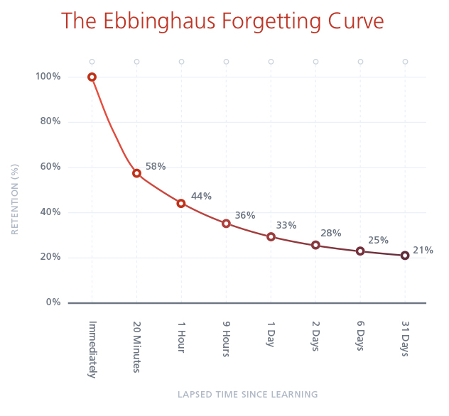
PRESENT
Forgetting is an important part of learning.
We need to review regularly to make information stick.
We need to make reviewing information a habit.
“We are a school community who celebrate inclusivity, ambition and aspirational learners”
Respect | Ambition | Resilience
Notes:
Explain to student about the theory of forgetting
We HAVE to forget – it’s an important part of learning!
The study by Ebbinghaus that has been replicated a number of times shows:
- Our brains forget things quickly, especially if we do not revisit them
- It is like when we hear a catchy song, but after a while we cannot remember the lyrics
Right after learning we forget a lot – but there is a trick that will support us to break the forgetting curve:
- If you review regularly – you can make the information stick
- we need to make reviewing the information we learn into a habit
- revisiting your notes and study material regularly

Slide 5

How can we interrupt the forgetting curve?
Spaced Practice
Make revision a habit
Builds your memory
Success in your exams
“We are a school community who celebrate inclusivity, ambition and aspirational learners”
Respect | Ambition | Resilience
Notes:
Spaced practice involves spacing out study sessions over time to enhance long –term retention. It is more effective than cramming as it helps the information through repeated exposure, reinforcing memory and promoting better recall during exams.
We will do the above via the Leitner System… next slide

Slide 6
Leitner System – Flashcards
PRESENT
Everyday
Tuesday & Thursday
Every Friday
“We are a school community who celebrate inclusivity, ambition and aspirational learners”
Respect | Ambition | Resilience
Notes:
This system will support you to remember without feeling overwhelmed:
Each time you get a card right, you move it up a pile/ higher level
If you don’t get it right it moves back to pile one
The effortful learning takes place when we focus on pile 2 & 3 and are getting them right!
This means we are breaking the forgetting curve!

Slide 7
Leitner System – Flashcards
PRESENT
Create flashcards
Put flashcards in Box 1
Review cards in Box 1 daily
If a card is answered correctly, move it to Box 2. An incorrect answers go back to Box 1.
Those in Box 2 when answered correctly, move to Box 3.
Gradually space out reviews for flashcards, reinforcing memory through spaced practice.
“We are a school community who celebrate inclusivity, ambition and aspirational learners”
Respect | Ambition | Resilience
Notes:
Give students a minute to read this and re – explain if necessary:
Each time you get a card right, you move it up a pile/ higher level
If you don’t get it right it moves back to pile one
The effortful learning takes place when we focus on pile 2 & 3 and are getting them right!
This means we are breaking the forgetting curve!

Slide 8
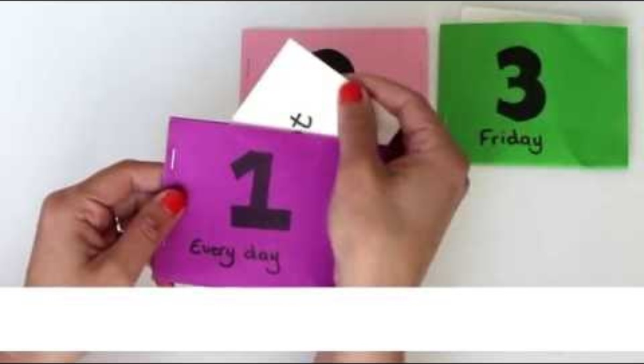
Video:
PRESENT
“We are a school community who celebrate inclusivity, ambition and aspirational learners”
Respect | Ambition | Resilience
Notes:
Give students a minute to read this and re – explain if necessary:
Each time you get a card right, you move it up a pile/ higher level
If you don’t get it right it moves back to pile one
The effortful learning takes place when we focus on pile 2 & 3 and are getting them right!
This means we are breaking the forgetting curve!

Slide 9
Flashcard Non-Example:
PRESENT
Non – Example:
William Shakespeare (26 April 1564 - 23 April 1616) was an English poet, playwright, and actor. He is often called the "Bard of Avon", a reference to his birthplace of Stratford-upon-Avon. He moved to London as an adult and many of his plays were performed there, at the Globe theatre. He wrote approximately 39 plays in total, including tragedies like Hamlet, comedies like A Midsummer Night's Dream and histories like Richard III.
“We are a school community who celebrate inclusivity, ambition and aspirational learners”
Respect | Ambition | Resilience
Notes:
This is a non – example, it is far too much information to recall – we need to break it down into smaller sections… next slide:

Slide 10
Flashcard Example:
PRESENT
Example:
Front
When did William Shakespeare live? 1564 - 1616
Back
1564 - 1616
“We are a school community who celebrate inclusivity, ambition and aspirational learners”
Respect | Ambition | Resilience
Notes:
This is a non – example, it is far too much information to recall – we need to break it down into smaller sections… next slide:

Slide 11
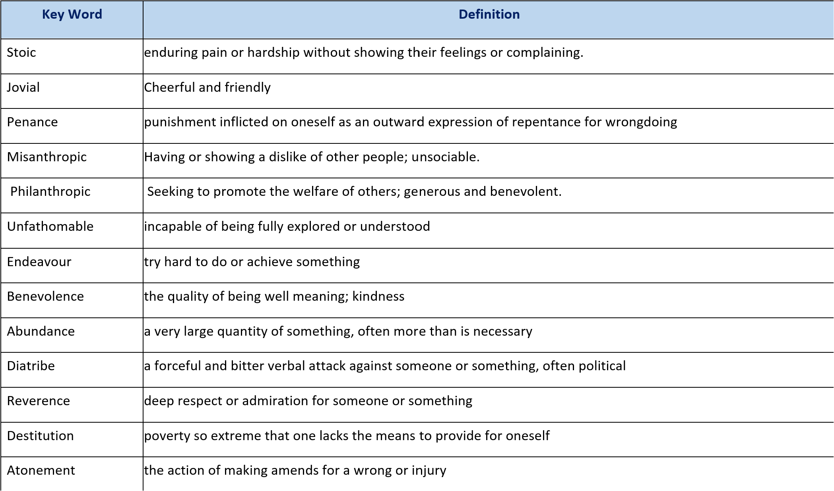
PRESENT
Example:
Where should you get your flashcard information from?
Option 1 – Your Topic Guides in your Independent Study Booklet!
FRONT:
Which word means ‘having or showing a dislike of other people; unsociable’?
BACK:
Misanthropic
“We are a school community who celebrate inclusivity, ambition and aspirational learners”
Respect | Ambition | Resilience
Notes:
This is a non – example, it is far too much information to recall – we need to break it down into smaller sections… next slide:

Slide 12
PRESENT
Example:
Where should you get your flashcard information from?
Option 1 – Your Topic Guides in your Independent Study Booklet!
FRONT:
Which characters can be described as misanthropic?
BACK:
Scrooge, Jacob Marley
“We are a school community who celebrate inclusivity, ambition and aspirational learners”
Respect | Ambition | Resilience
Notes:
This is a non – example, it is far too much information to recall – we need to break it down into smaller sections… next slide:

Slide 13
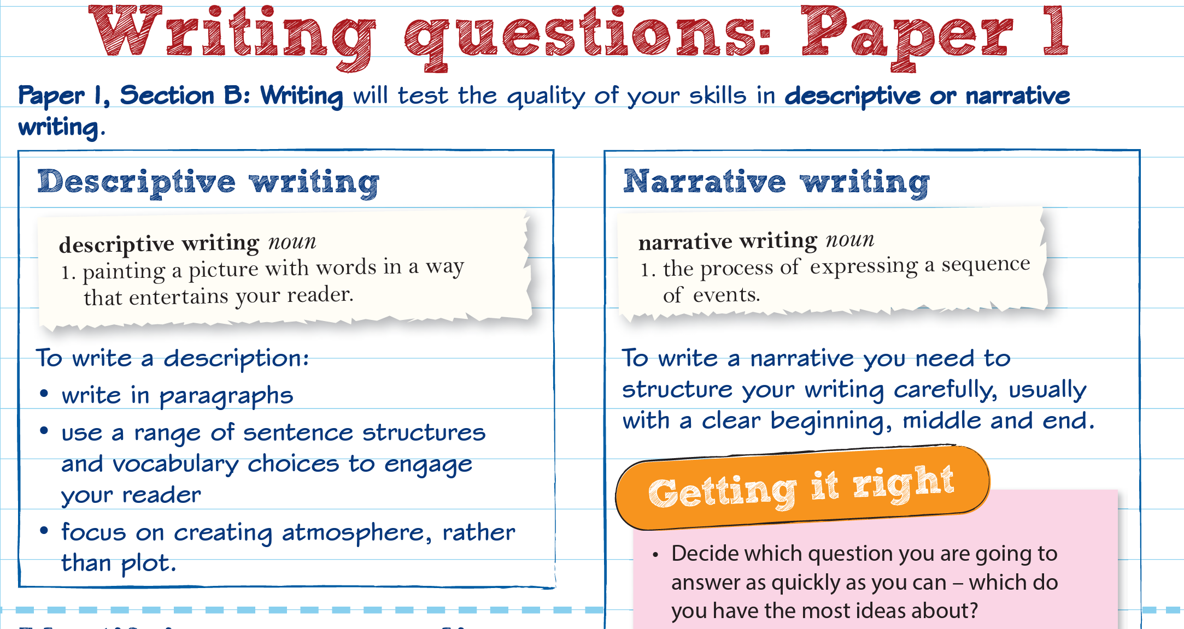
Where should you get your flashcard information from?
Option 2 – Pearson Revise!
Remember – you all have FREE login; they have content for every subject; you just need your usual school Microsoft login!
PRESENT
Example:
FRONT:
What 4 things should you consider for descriptive writing?
BACK:
Paragraphs
Sentence structures
Vocabulary
Atmosphere
“We are a school community who celebrate inclusivity, ambition and aspirational learners”
Respect | Ambition | Resilience
Notes:
This is a non – example, it is far too much information to recall – we need to break it down into smaller sections… next slide:

Slide 14
Your teacher will now circulate and give you feedback
REVIEW
Concise
Clear
Subject-specific vocabulary
Methods focused (Maths)
“We are a school community who celebrate inclusivity, ambition and aspirational learners”
Respect | Ambition | Resilience
Notes:
Students will work independently and then the teacher will purposefully circulate and support
After 10 minutes please use the visualiser to share good examples to the class
If the teacher could demonstrate the Leitner System this would support students to see how it is used successfully
Students to choose one of the tasks – Maths or English
Maths – flashcards needs to be very focused on methods, not just answers

Slide 15
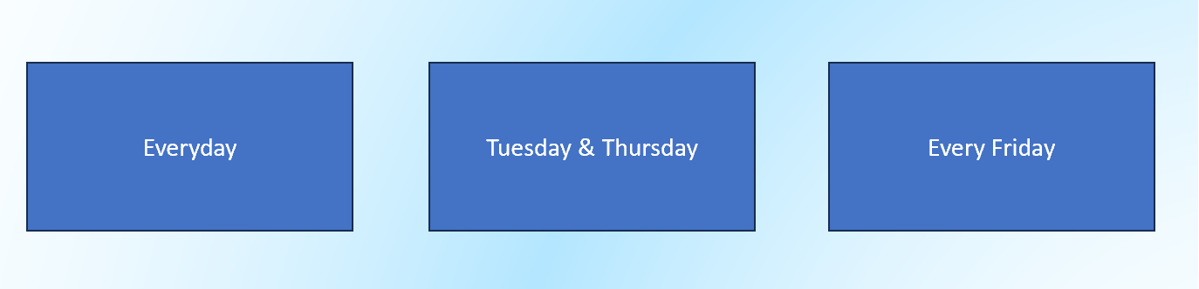
Task:
APPLY
Put flashcards in Box 1
Test yourself/each other on these flashcards
If a card is answered correctly, move it to Box 2. An incorrect answer stays in Box 1.
Using your flashcards, practice using the Leitner system with your flashcards
“We are a school community who celebrate inclusivity, ambition and aspirational learners”
Respect | Ambition | Resilience
Notes:
Students will work independently and then the teacher will purposefully circulate and support
After 10 minutes please use the visualiser to share good examples to the class
If the teacher could demonstrate the Leitner System this would support students to see how it is used successfully
Students to choose one of the tasks – Maths or English
Maths – flashcards needs to be very focused on methods, not just answers

Slide 16
Takeaway:
REVIEW
Keep your flashcards clear and focused on key concepts
Include questions or prompts on one side with answers on the other.
Build the habit of reviewing information by using the Leitner System:
“We are a school community who celebrate inclusivity, ambition and aspirational learners”
Respect | Ambition | Resilience

Slide 17
ORIENTATE
DO NOW
Write your answers in full sentences in your exercise books.
1. What revision strategies do you use?
2. Have you used the Leitner System in your flashcard revision?
3. How do you know they are successful?
4. What difficulties do you encounter with the Leitner System and how can we overcome these?
“We are a school community who celebrate inclusivity, ambition and aspirational learners”
Respect | Ambition | Resilience
Notes:
Students to answer in exercise books where possible
After a calm, quiet entry and the register, tutors can then use the questions to invoke some class discussion
Draw attention particularly to the final question – illicit that we (staff at The Albion) are there to support our students with their revision and the strategies we will offer to support them with are rooted in educational research.
Today's session will focus on one of two strategies that we are encouraging all students to use because there is a strong evidence base that they are successful with supporting consolidation and success.

